Slide 1
Logic and Proofs
Sections 1.6, 1.7

Slide 2
Rules of Inference
Section 1.6

Slide 3
Video 10: Valid Arguments
Arguments
Argument Forms
Inference Rules
Valid Arguments

Slide 4
Example
Assume the following rule holds
“If I have passed AICC, I can advance to year 2 of the studies”
And assume that you know
“I have passed AICC”
Then you would conclude
“I can advance to year 2 of the studies”
This is a valid argument

Slide 5
Example
Assume the following rule holds
“If I have passed AICC, I can advance to year 2 of the studies”
And assume that you know
p := “I have passed AICC”
Then you would conclude
q : = “I can advance to year 2 of the studies”

Slide 6
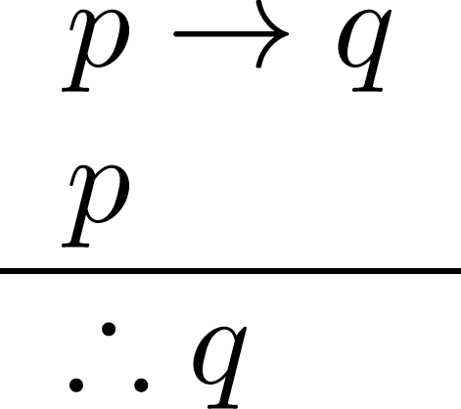
Example
Assume the following rule holds
p → q
And assume that you know
p
Then you would conclude
q
This is a valid argument form
It is true for any p and q
It is written as
It is called Modus Ponens

Slide 7
Why is the Argument Form Valid?
We know that (p ∧ (p → q) ) → q is a tautology
So if we know that p and p → q are True, then the premise (p ∧ (p → q)) is True, and therefore also q is True
This holds for any tautology of the form (p₁ ∧ p₂ ∧ … ∧ p_{n}) → q
Note: if at least one of the premises is not True, we cannot conclude that the conclusion is True

Slide 8
Arguments in Propositional Logic
A argument in propositional logic is a sequence of propositions.
All but the final proposition are called premises.
The last statement is the conclusion.
The argument is valid if the premises imply the conclusion.
An argument form is an argument that is valid no matter what propositions are substituted into its propositional variables
Inference rules are simple argument forms that will be used to construct more complex argument forms

Slide 9
What is this good for?
Assume the following rule holds
“If I have passed AICC and if I have passed Analysis 1 and if I have passed Linear Algebra and …. (list all your courses here), I can advance to year 2 of the studies”
And assume that you know
p₁ := “I have passed AICC”
p₂ := “I have passed Analysis 1”
p₃ := “I have passed Linear Algebra” …
(and all other courses here)
Then you would conclude
q : = “I can advance to year 2 of the studies”

Slide 10
Using a Truth Table
Now build the truth table for (p₁ ∧ p₂ ∧ … ∧ p_{n}) → q
to show that the argument holds
where n = 20 is the number of courses
The table will have 2²⁰ = 1’048’576 rows, which is not very practical

Slide 11
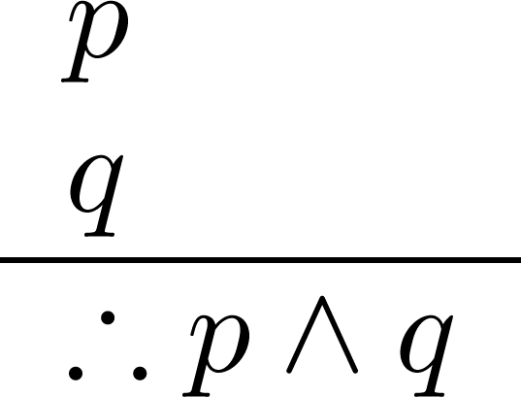
Using Inference Rules
We have another inference rule: Conjunction Inference Rule ( p ∧ q → p ∧ q is a tautology )
Now we can provide the argument in a much simpler way!

Slide 12
Building the Argument
Write down what we know (the premises)
p₁ p₂ … p_{n}
(p₁ ∧ p₂ ∧ … ∧ p_{n}) → q

Slide 13
Building the Argument
Apply the Conjunction Inference Rule to the first two premises
p₁ p₂ … p_{n}
(p₁ ∧ p₂ ∧ … ∧ p_{n}) → q
p₁ ∧ p₂

Slide 14
Building the Argument
Apply the Conjunction Inference Rule to the new and the third premise
p₁ p₂ … p_{n}
(p₁ ∧ p₂ ∧ … ∧ p_{n}) → q
p₁ ∧ p₂
p₁ ∧ p₂ ∧ p₃

Slide 15
Building the Argument
Repeat for all other p_{i}
p₁ p₂ … p_{n}
(p₁ ∧ p₂ ∧ … ∧ p_{n}) → q
p₁ ∧ p₂
…
(p₁ ∧ p₂ ∧ … ∧ p_{n})

Slide 16
Building the Argument
Apply Modus Ponens and obtain the conclusion
p₁ p₂ … p_{n}
(p₁ ∧ p₂ ∧ … ∧ p_{n}) → q
p₁ ∧ p₂
…
(p₁ ∧ p₂ ∧ … ∧ p_{n})
∴ q

Slide 17

Using the Inference Rules to Build Valid Arguments
A valid argument is a sequence of statements.
Each statement is either a premise or follows from previous statements by inference rules.
The last statement is called conclusion.
A valid argument takes the following form:
Step₁
Step₂
.
.
.
Step_{n}
Conclusion

Slide 18
Summary
Arguments
Argument Forms
Inference Rules
Valid Arguments

Slide 19
Video 11: Inference Rules in Propositional Logic
Important inference rules
Examples
Fallacies

Slide 20
Inference Rules
Propositional Logic: Inference Rules
Predicate Logic: Inference rules for propositional logic plus additional inference rules to handle variables and quantifiers

Slide 21
Conjunction and Modus Ponens
Corresponding Tautology:
(p ∧ q) → (p ∧ q)
Corresponding Tautology:
(p ∧ (p →q)) → q

Slide 22
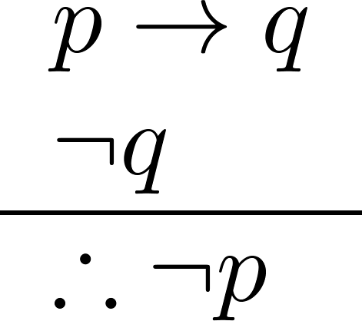
Inference Rule: Modus Tollens
Corresponding Tautology:
(¬q ∧ (p →q)) → ¬p
Example:
p := “I have passed AICC”
q := “I can advance to year 2 of the studies”
Premises
“If I have passed AICC, I can advance to year 2 of the studies”
“I cannot advance to year 2 of the studies.”
Conclusion
“I did not pass AICC.”

Slide 23
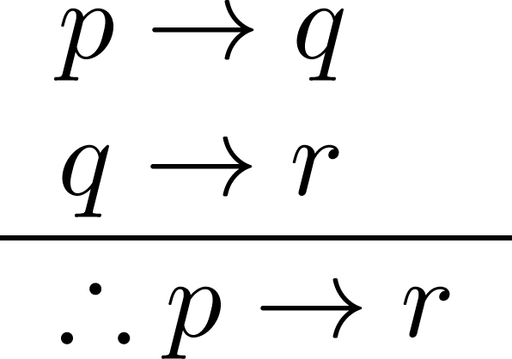
Hypothetical Syllogism
Corresponding Tautology:
((p →q) ∧ (q→r)) → (p→ r)
Example:
r := “I can take Analysis 4”
Premises
“If I have passed AICC, I can advance to year 2 of the studies”
“If I can advance to year 2 of the studies, I can take Analysis 4”
Conclusion
“If I have passed AICC, I can take Analysis 4”

Slide 24
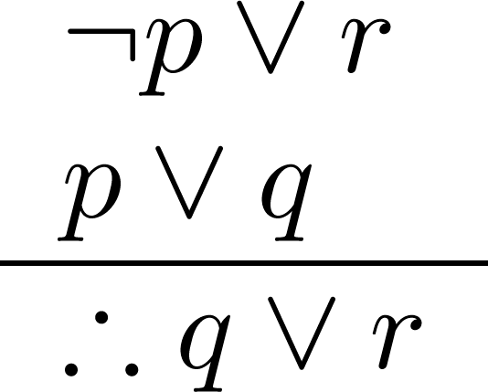
Resolution
Corresponding Tautology:
((¬p ∨ r ) ∧ (p ∨ q)) → (q ∨ r)
Example:
p := “The weather is nice
q := “I am at home”
r := “I am at the beach”
Premises:
“The weather is bad or I am at the beach”
“The weather is nice or I am at home”
Conclusion:
“I am at home or at the beach”
Resolution plays an important role in automated theorem proofing and AI
It allows to eliminate propositional variables from the premises

Slide 25
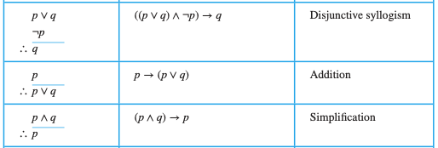
Other Inference Rules
Simpler form of resolution
Dual to Conjunction
Simpler form of Modus Ponens

Slide 26
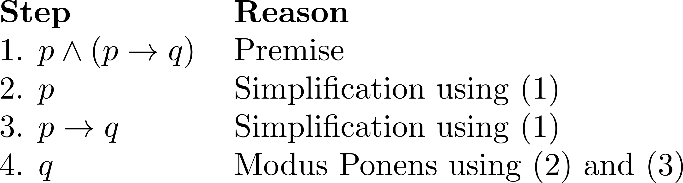
Valid Arguments
Attention: even seemingly “obvious” conclusions imply an argument
Example: From p ∧ (p →q) conclude q
Argument:

Slide 27
Example
With these hypotheses:
“It is not sunny this afternoon and it is colder than yesterday.”
“We will go swimming only if it is sunny.”
“If we do not go swimming, then we will take a canoe trip.”
“If we take a canoe trip, then we will be home by sunset.”
Using the inference rules, construct a valid argument for the conclusion:
“We will be home by sunset.”

Slide 28
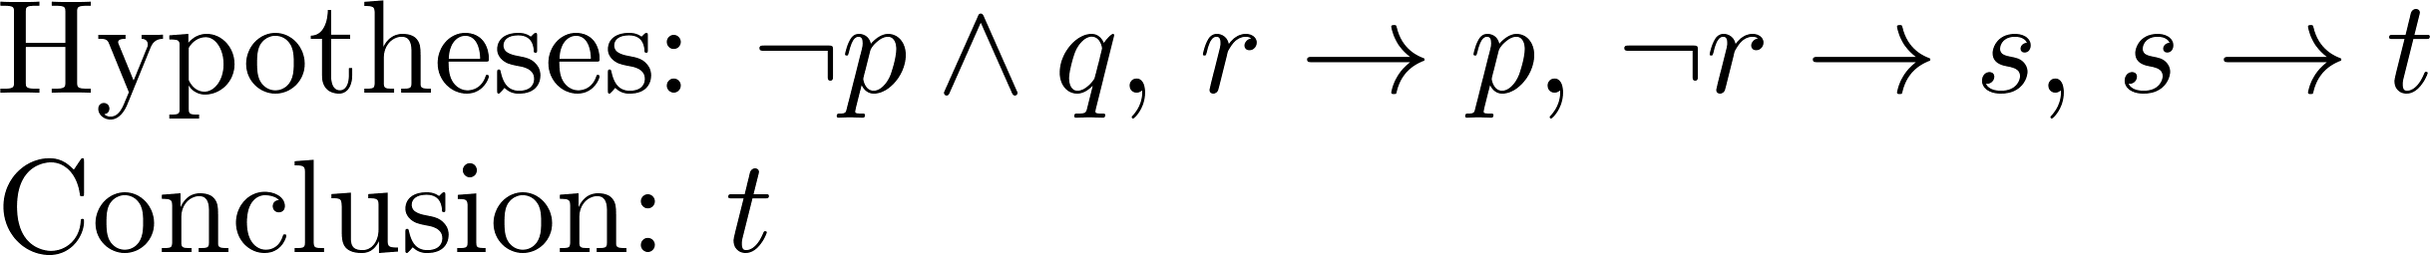
Example
1. Choose propositional variables:
p := “It is sunny this afternoon.”
r := “We will go swimming.”
t := “We will be home by sunset.”
q := “It is colder than yesterday.”
s := “We will take a canoe trip.”
2. Translate into propositional logic:

Slide 29
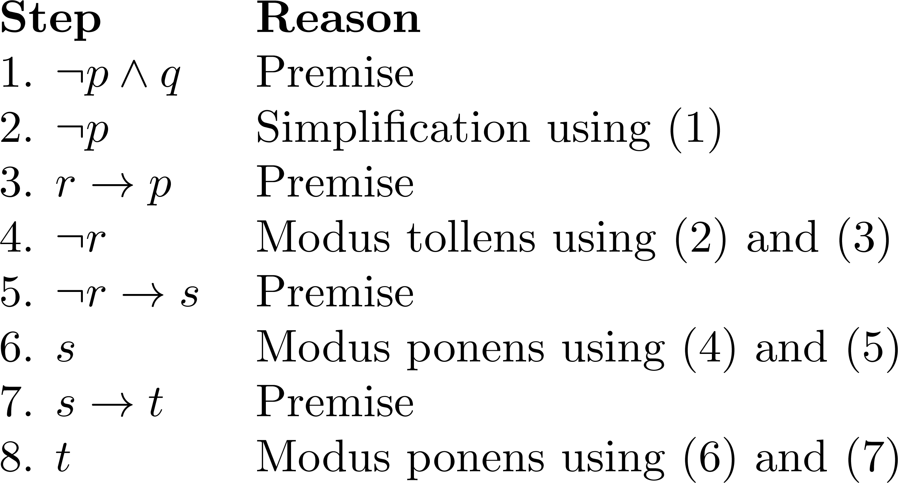
Example
3. Construct the Valid Argument

Slide 30
Fallacies!
((p → q) ∧ q) → p is not a tautology
fallacy of affirming the conclusion
Example:
If you do every problem in this book, then you will learn discrete mathematics. You learned discrete mathematics.
Therefore, you did every problem in this book?

Slide 31
Fallacies!
((p → q) ∧ ¬p) → ¬q is not a tautology
fallacy of denying the hypothesis
Example:
If you do every problem in this book, then you will learn discrete mathematics. You did not do every problem in this book.
Therefore, you did not learn discrete mathematics?

Slide 32
Summary
Modus Ponens, Modus Tollens
Hypothetical Syllogism
Resolution
How to build valid arguments
Fallacies
affirming the conclusion
denying the hypothesis

Slide 33
Video 12: Arguments in Predicate Logic
Inference Rules for Quantifiers
Building valid arguments

Slide 34
Handling Quantified Statements
Valid arguments for quantified statements are a sequence of statements.
Each statement is either a premise or follows from previous statements by rules of inference which include:
Rules of Inference for Propositional Logic
Rules of Inference for Quantified Statements

Slide 35
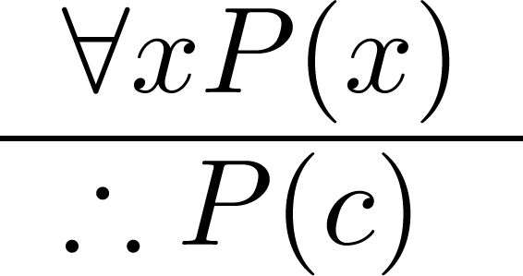
Universal Instantiation (UI)
Example: The domain consists of all Men and Socrates is a Man
Premise:
“All men are mortal.”
Conclusion:
“Therefore, Socrates is mortal.”

Slide 36
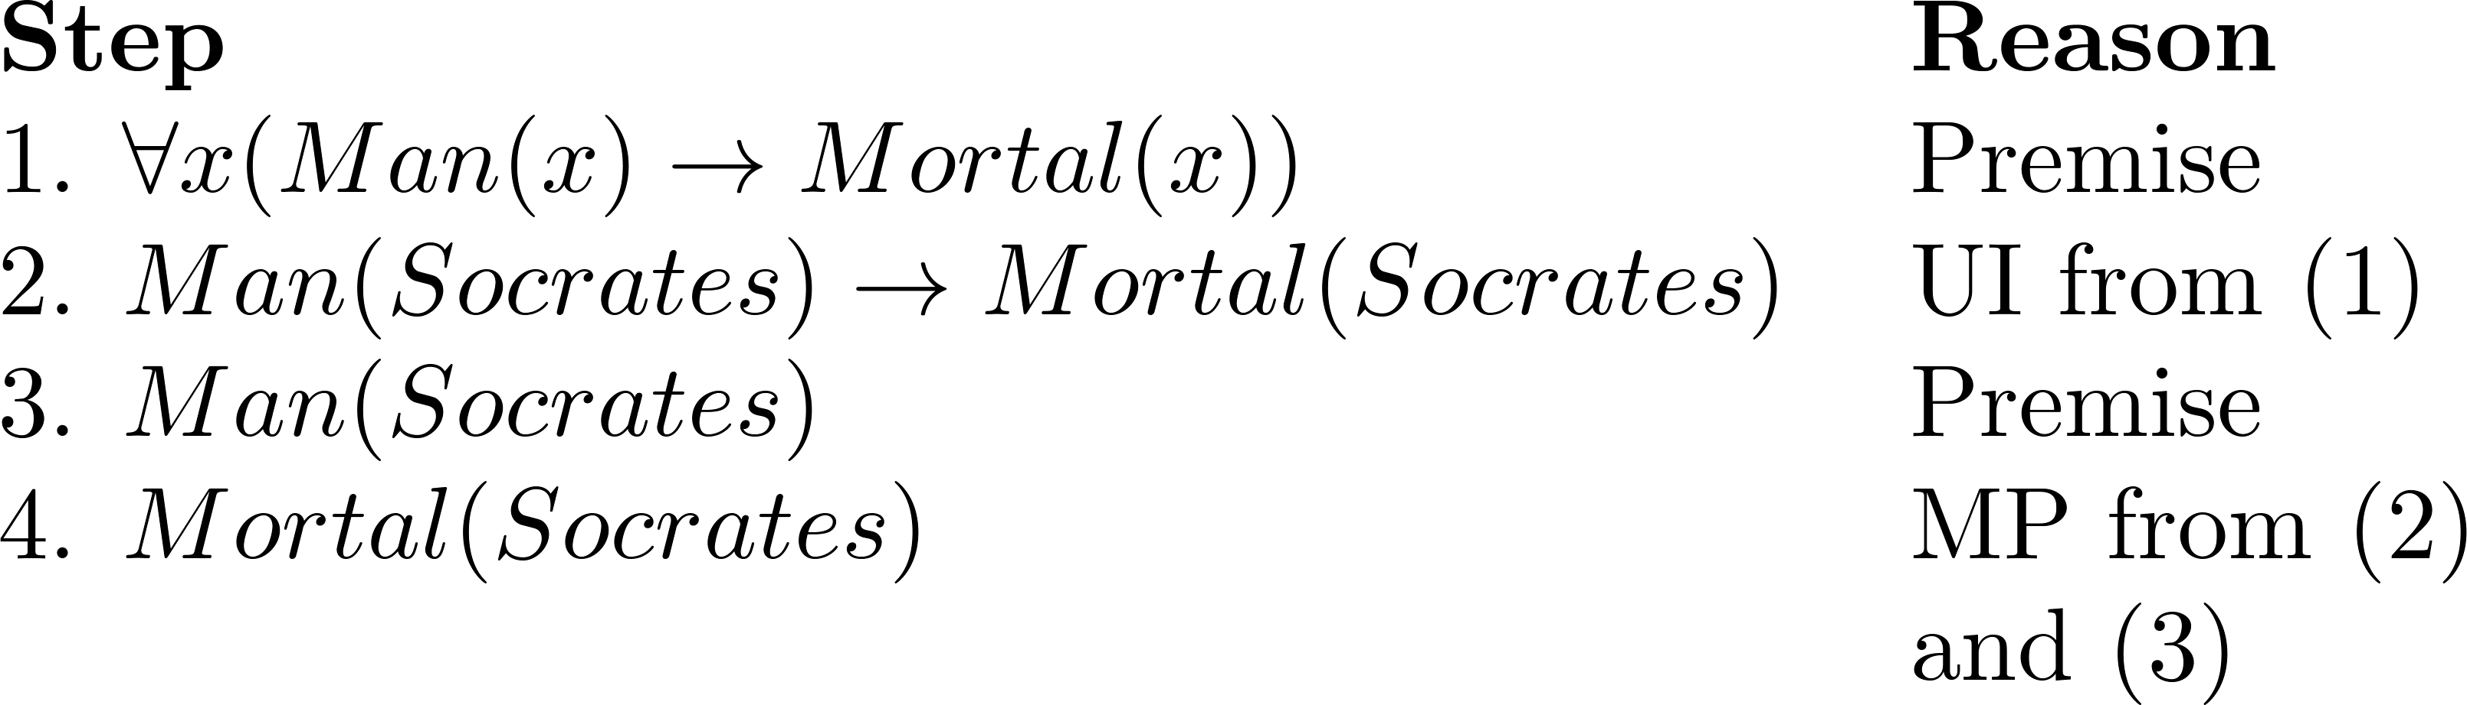
Solution for Socrates Example
If we choose a more general domain, e.g. all beings, including gods and spirits, we need a more elaborate proof to build a valid argument
Both rules for propositional logic and quantifiers

Slide 37
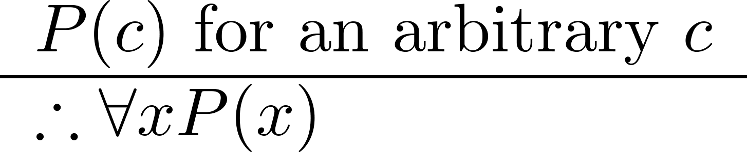
Universal Generalization (UG)
Used often implicitly in Mathematical Proofs.
Attention: you must not make any assumptions about c

Slide 38
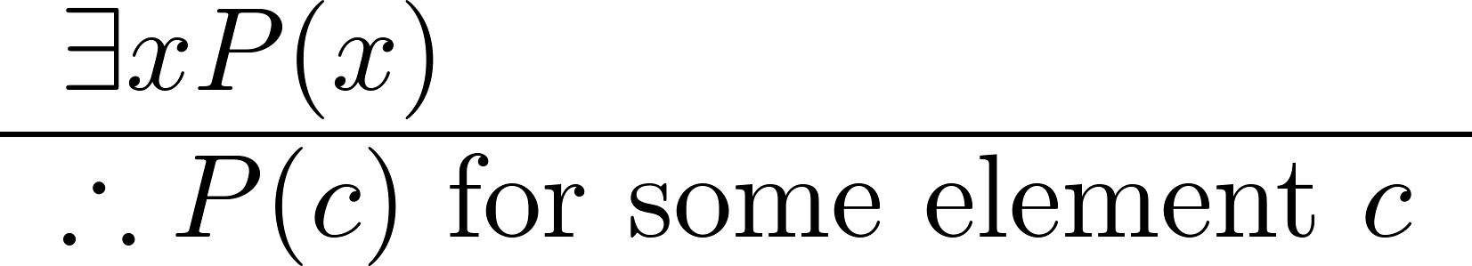
Existential Instantiation (EI)
Example:
“There is someone who knows Java in the class.”
“Let’s call her a and say that a knows Java”

Slide 39
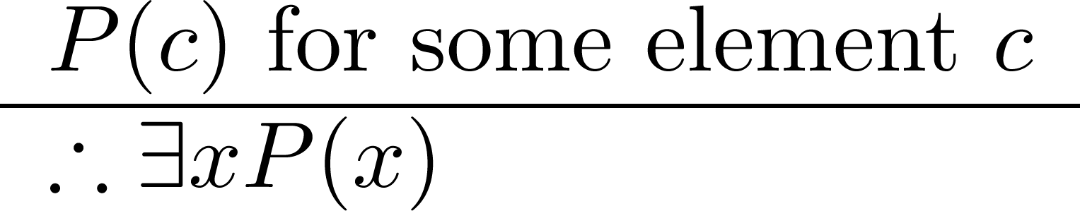
Existential Generalization (EG)
Example:
“Michelle knows Java in the class.”
“Therefore, someone knows Java in the class.”

Slide 40
Example
Use the rules of inference to construct a valid argument showing that the conclusion
“Someone who passed the first exam has not read the book.”
follows from the premises
“A student in this class has not read the book.”
“Everyone in this class passed the first exam.”

Slide 41
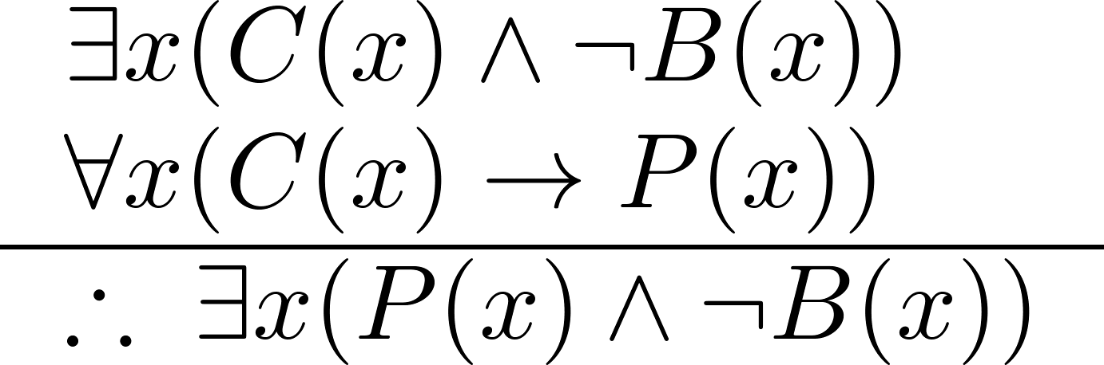
Example
Let
C(x) := “x is in this class”
B(x) := “ x has read the book”
P(x) := “x passed the first exam”
Translate the premises and conclusion into predicate logic

Slide 42
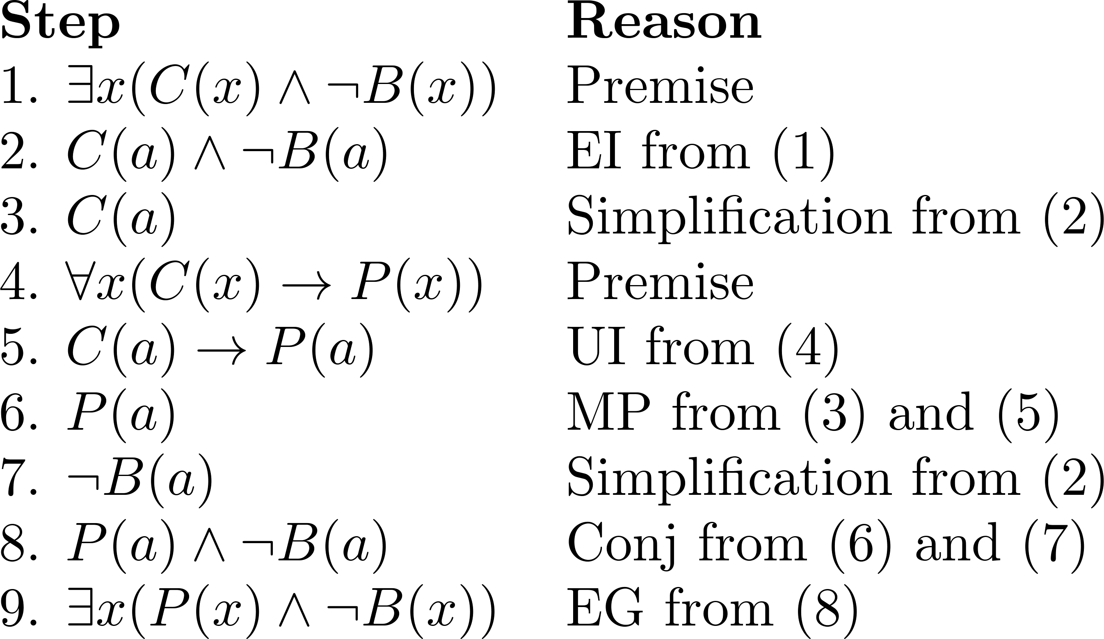
Example
Construct the valid argument

Slide 43
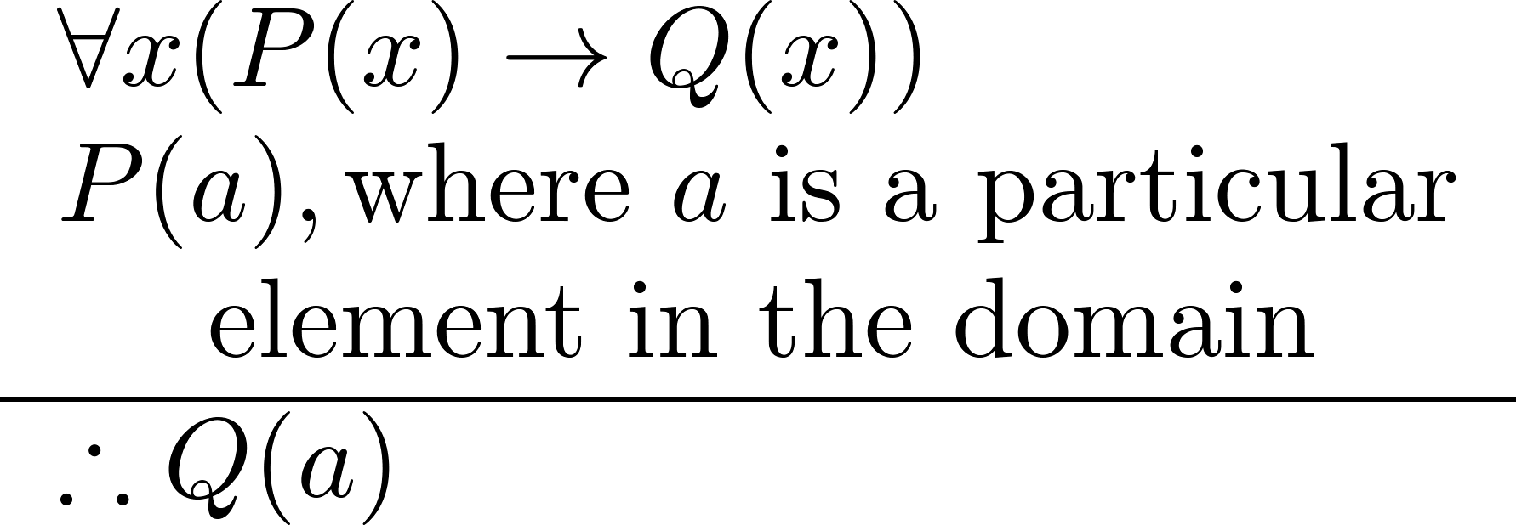
Universal Modus Ponens
Universal Modus Ponens combines universal instantiation and modus ponens into one rule.
This rule could be used in the Socrates example.

Slide 44
Summary
Inference Rules for Quantifiers
Universal Instantiation
Universal Generalization
Existential Instantiation
Existential Generalization
Universal Modus Ponens

Slide 45
Introduction to Proofs
Section 1.7, 1.8.2, 1.8.6

Slide 46
Video 13: Introduction to Proofs
Theorems
Mathematical Proofs
Types of Proofs

Slide 47
Proofs of Mathematical Statements
An axiom is a statement which is given as true
A theorem is a statement that can be shown to be true using
definitions
axioms
other theorems
rules of inference
A mathematical proof is a valid argument that establishes the truth of a statement
in particular of a theorem

Slide 48
Informal Proofs
In mathematics, computer science, and other disciplines, informal proofs, which are generally shorter, are often used
More than one rule of inference is used in a step
Steps may be skipped
The rules of inference used are not explicitly stated
Easier for to understand and to explain to people
But it is also easier to introduce errors

Slide 49
Applications of Proofs
Apart from being at the core of mathematics, proofs have many practical applications as well
verification that computer programs are correct
establishing that operating systems are secure
enabling programs to make inferences in artificial intelligence
showing that system specifications are consistent

Slide 50
Terminology
A lemma is a ‘helping theorem’ or a result which is needed to prove a theorem
A corollary is a result which follows directly from a theorem
Less important theorems are sometimes called propositions
A conjecture is a statement that is being proposed to be true. Once a proof of a conjecture is found, it becomes a theorem. It may turn out to be false.
Example: Fermat’s theorem has been a conjecture from 1634 - 1995

Slide 51
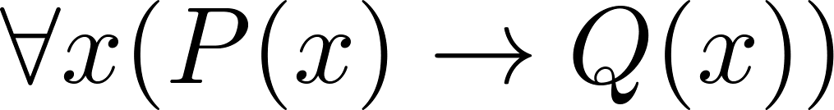
Forms of Theorems
Many theorems assert that a property holds for all elements in a domain, such as the integers, the real numbers, or discrete structures

Slide 52
Formulation of Theorems
Often the universal quantifier (needed for a precise statement of a theorem) is omitted by standard mathematical convention.
For example, the statement:
“If x > y, where x and y are positive real numbers, then x² > y² ”
really means
“For all positive real numbers x and y, if x > y, then x² > y² .”

Slide 53
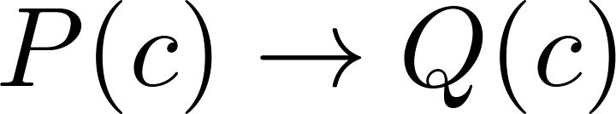

Proving Theorems
To prove theorems of the form we show that
where c is an arbitrary element of the domain.
By universal generalization the truth of the original formula follows.
So, we must prove a statement of the form:

Slide 54
Proving Conditional Statements: p → q
Trivial Proof: If we know q is true, then p → q is true as well.
“If it is raining then 1 = 1.”
Vacuous Proof: If we know p is false then p → q is true as well.
“If I am both rich and poor then 2 + 2 = 5.”
Notes:
[ Even though these examples seem silly, both trivial and vacuous proofs are often used in mathematical induction, as we will see later) ]

Slide 55
Direct Proofs for p → q
Direct Proof: assume that p is true; then use definitions, axioms and theorems together with rules of inference till the statement q results

Slide 56
Indirect Proofs for p → q
Proof by Contraposition: assume that ¬q is True; then use definitions, axiom and theorems together with rules of inference till the statement ¬p results
Since p → q ≡ ¬q → ¬p the statement is proven
This is one type of an indirect proof

Slide 57
Indirect Proofs for p → q
Proof by Contradiction: assume that p and ¬q are true; then perform a direct proof to construct a contradiction, i.e., prove the statement F
Since p → q ≡ (p ∧ ¬q) → F the statement is proven.
AKA reductio ad absurdum, another type of indirect proof

Slide 58
Summary
Axiom, Theorem, Proof
Corollary, Lemma, Proposition, Conjecture
Trivial and Vacuous Proof
Direct Proof
Indirect Proof: by contraposition and by contradiction

Slide 59
Video 14: Proof Examples
Examples for direct and indirect proofs
Other proof methods
Mistakes in proofs

Slide 60
Theorem on Even and Odd Integers
Definition: The integer n is even if there exists an integer k such that n = 2k, and n is odd if there exists an integer k, such that n = 2k + 1.
Theorem: If n is an odd integer, then n² is odd.
Example: n = 3 is odd, then 3² = 9 is odd.
Note: every integer is either even or odd and no integer is both even and odd. Strictly speaking, this requires a proof.

Slide 61
Direct Proof
Proof:
Assume that n is odd.
Then n = 2k + 1 for an integer k, according to the definition.
Squaring both sides of the equation, we get:
n² = (2k + 1)² = 4k² + 4k +1 = 2(2k² + 2k) + 1
Setting r = 2k² + 2k , an integer, we obtain
n² = 2r + 1,
Thus, n² is an odd integer, according to the definition.
( marks the end of the proof. Sometimes QED is used instead. )

Slide 62
Theorem on Sum of Rational Numbers
Definition: The real number r is rational if there exist integers p and q where q ≠ 0 such that r = p/q
Theorem: The sum of two rational numbers is rational.

Slide 63
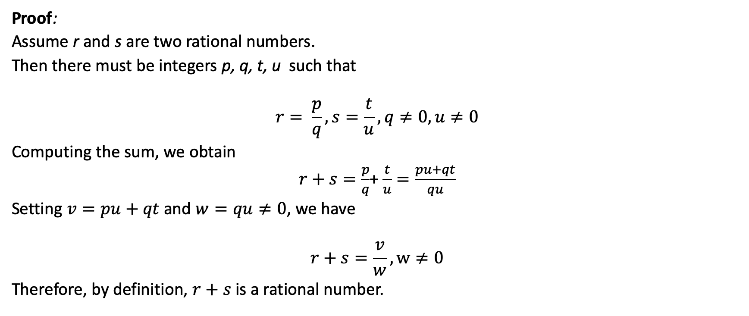
Direct Proof
Proof:
Assume r and s are two rational numbers.
Then there must be integers p, q, t, u such that
$$r= \frac{p}{q}, s=\frac{t}{u},q≠0,u≠0$$
Computing the sum, we obtain
$r+s=\frac{p}{q}$+ $\frac{t}{u}=\frac{pu+qt}{qu}$
Setting $v=pu+qt$ and $w=qu≠0$, we have
$$r+s=\frac{v}{w},w≠0$$
Therefore, by definition, $r+s$ is a rational number.

Slide 64
Proof by Contraposition
Theorem: If n is an integer and 3n + 2 is odd, then n is odd.
Proof: Assume n is even. So, n = 2k for some integer k.
Thus
3n + 2 = 3(2k) + 2 =6k +2 = 2(3k + 1) = 2j for j = 3k +1
Therefore 3n + 2 is even.
Since we have shown ¬q → ¬p , p → q must hold as well.

Slide 65
Proof by Contraposition
Theorem: For an integer n, if n² is odd, then n is odd.
Proof: Assume n is even.
Therefore, there exists an integer k such that n = 2k. Hence,
n² = 4k² = 2 (2k²)
and n² is even.
We have shown that if n is an even integer, then n² is even.
Therefore, by contraposition, for an integer n, if n² is odd, then n is odd.

Slide 66
Proof by Contradiction
Theorem: If more than N items are distributed in any manner over N bins, there must be a bin containing at least two items (pigeonhole principle).
Proof:
Assume that each bin contains at most a single item (¬q),
and that there are more than N items (p).
However, as we have only N bins and each bin contains at most one item, there are at most N items (¬p).
This contradicts the assumption that there are more than N items (p).
Notes:
This looks still like a proof by contraposition.
If we can show that (p and not q) -> not p
Since (p and not q) -> p
We have p -> q by contradiction
But now this argument holds also for any other r

Slide 67
Contraposition vs. Contradiction
The previous proof can also be interpreted as proof by contraposition.
Assuming ¬q is true we made a direct proof of ¬p, and thus proved ¬q → ¬p
More generally, any proof by contraposition can be tansformed in a proof by contradiction, but not vice versa:
If you assume that p and ¬q are true and you have a direct proof for ¬q → ¬p then you have shown that (p ∧ ¬q) → (p ∧ ¬p) ≡ F
General proofs by contradiction use some other statement r that produces the contradiction, i.e., we prove (p ∧ ¬q) → (r ∧ ¬r)

Slide 68
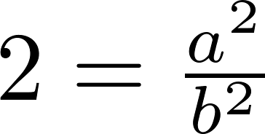
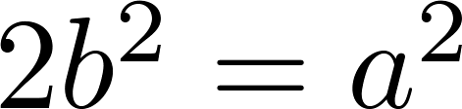
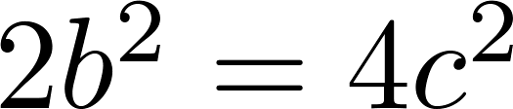
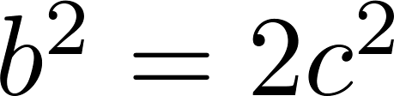
Proof by Contradiction
Theorem: √2 is irrational
Proof: Suppose √2 is rational. Then there exist integers a and b with √2 = a/b, where b≠ 0 and a and b have no common factors. Then
Therefore a² must be even. If a² is even then a must be even (a theorem). Since a is even, a = 2c for some integer c. Thus,
Therefore b² is even. Again then b must be even as well.
But then 2 must divide both a and b. This contradicts our assumption that a and b have no common factors. We have proved by contradiction that our initial assumption must be false and therefore √2 is irrational .
Note: Statement r is that ”a and b have no common factors”
Notes:
P = Not q -> not p = p -> q
Not P = p and not q
Not P ->

Slide 69
Proofs for Biconditional Statements
To prove a theorem that is a biconditional statement, that is, a statement of the form p ↔ q, we show that p → q and q →p are both true.
Theorem: If n is an integer, then n is odd if and only if n² is odd.
Proof:
We have already shown that both p → q and q → p.
Therefore we can conclude p ↔ q.

Slide 70
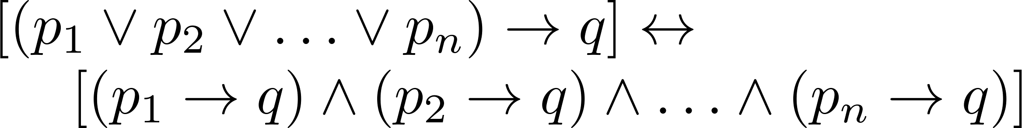

Proof by Cases
To prove a conditional statement of the form:
use the tautology
Each of the implications is a case.

Slide 71
Proof by Cases
Theorem: if n is an integer, then n² ≥ n.
Proof: Consider three cases: n = 0, n ≥ 1, n ≤ -1
Case (i): n = 0
Since 0² = 0, we have 0² ≥0. It follows that n² ≥ n in this case.
Case (ii): n ≥ 1
We multiply both sides of the inequality n ≥ 1 by the positive integer n, and obtain n⋅n ≥ n⋅1. It follows that n² ≥ n in this case
Case (iii): n ≤ −1
Since n² ≥ 0, it follows that n² ≥ n in this case

Slide 72
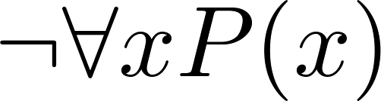
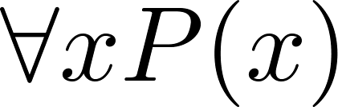
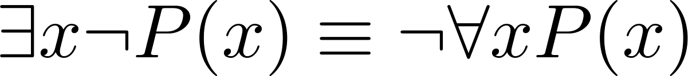
Proof by Counterexample
To establish that is true (or is false) find a c such that ¬P(c) is true or P(c) is false.
Reminder:
In this case c is called a counterexample to the assertion .
Example:
Show that the statement “Every positive integer is the sum of the squares of 2 integers.” is False.
The integer 3 is a counterexample. Why?

Slide 73
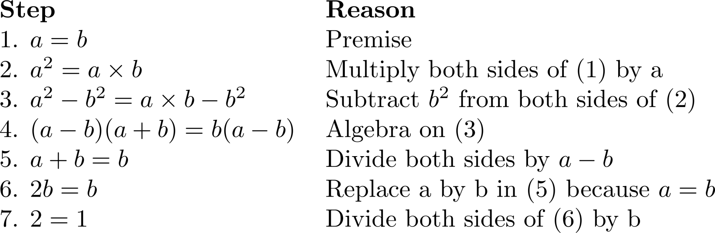
Mistakes in Proofs
“Proof” that 1 = 2
Answer: Step 5. a - b = 0 by the premise and division by 0 is undefined.

Slide 74
Mistakes in Proofs
“Proof” that 2 = 1
What went wrong?
Step 5: a - b = 0 by the premise and division by 0 is undefined.

Slide 75
Summary
Examples of direct and indirect proofs
Proofs for Biconditional Statements
Proof by Cases
Counterexamples
Mistakes in Proofs

